Slide 1
Artificial Intelligence
By Sithvothy KIV

Slide 2
Git and GitHub
Understand Git fundamentals and set up a repository

Slide 3
Git Basics
‹#›
What is Git?
Definition: Distributed version control system for tracking code changes.
Why Use Git?
Track the history of changes.
Collaborate without overwriting work.
Revert to previous versions.
Git vs. GitHub
Git: Local version control system
GitHub: Cloud platform for hosting Git repositories

Slide 4
Git Basics
‹#›
Use GitHub/GitLab/Bitbucket to manage repositories
Maintain separate branches:
main -> Stable production-ready code
dev -> Experimental features and testing
staging -> Pre-production validation
Store large model files using DVC (Data Version Control) or cloud storage (AWS S3, Google Cloud Storage).

Slide 5
Key Git Commands
‹#›
Command | Purpose
git init | Initialize a new repository.
git clone <url> | Copy an existing repository.
git add <file> | Stage changes for commit.
git commit -m "msg" | Save changes with a message.
git branch <name> | Create a new branch.
git merge <branch> | Combine branches.

Slide 6
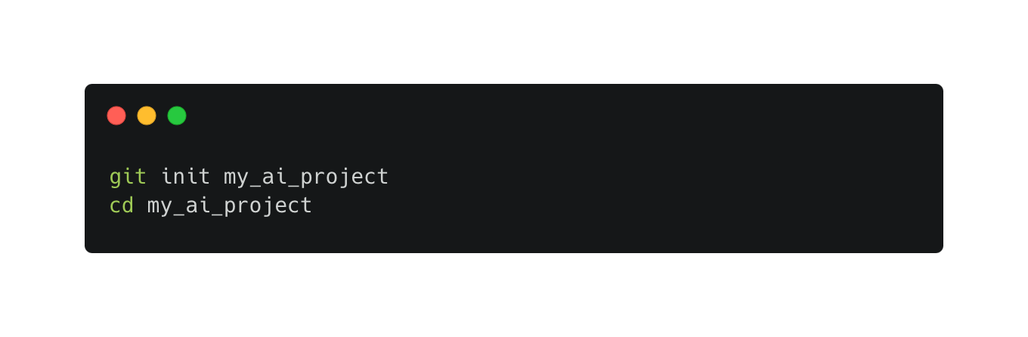
Key Git Commands
‹#›
Create a repo

Slide 7
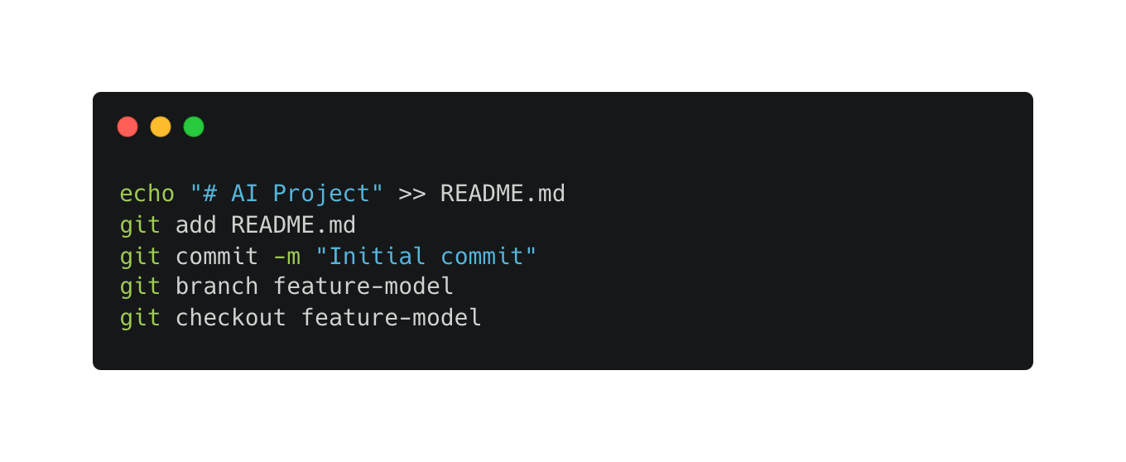
Key Git Commands
‹#›
Add, commit, and branch

Slide 8
GitHub Collaboration
Learn pull requests, issues, and team workflows
‹#›

Slide 9
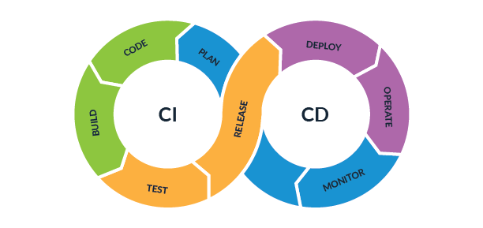
GitHub Features
‹#›
Pull Requests (PR): Propose changes and review code.
Issues: Track bugs, enhancements, or tasks.
Actions: Automate CI/CD pipelines.

Slide 10
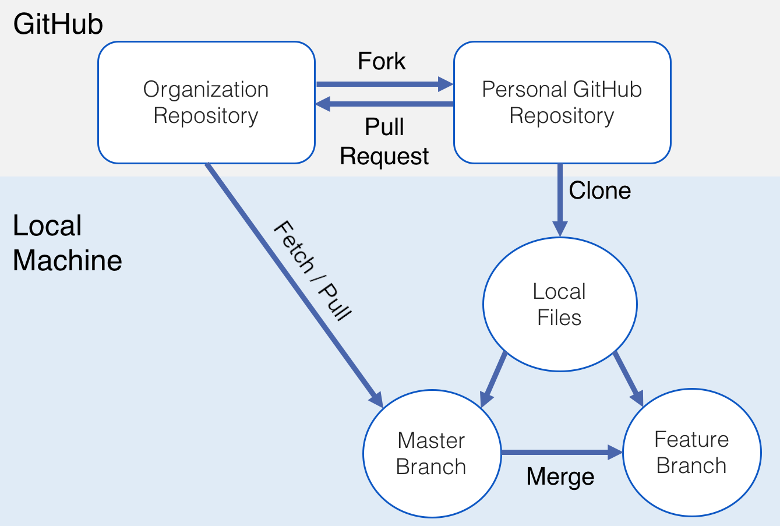
GitHub Features
‹#›

Slide 11
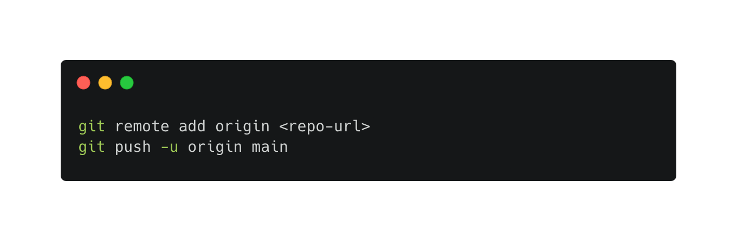
GitHub Features
‹#›
Create a GitHub repository and push code:

Slide 12
GitHub Features
‹#›
Simulate collaboration:
Create a PR from feature-model to main.
Resolve a merge conflict.
Close an issue with a PR.

Slide 13
‹#›
Any questions?

Slide 14
Demo Time!
‹#›

Slide 15
Homework
‹#›
Set up a GitHub repository for AI project
Add/Commit existing project
Create an issue
Document guildeline
Submit/Share the link

